Slide 1
“my first website”
曾婕寧 4100E227
Mydeargreatteacher

Slide 2
agenda
Web programming
Web server and database
HTML programming
CSS
JAVAscript
My funny web site

Slide 3
Web programming

Slide 4
“Web Programming”
Web programming refers to the writing, markup and coding involved in Web development, which includes Web content, Web client and server scripting and network security. The most common languages used for Web programming are XML, HTML, JavaScript, Perl 5 and PHP. Web programming is different from just programming, which requires interdisciplinary knowledge on the application area, client and server scripting, and database technology.

Slide 5
Web programming can be briefly categorized into client and server coding. The client side needs programming related to accessing data from users and providing information. It also needs to ensure there are enough plug ins to enrich user experience in a graphic user interface, including security measures. To improve user experience and related functionalities on the client side, javascript is usually used. It is an excellent client-side platform for designing and implementing web applications. HTML5 and CSS3 supports most of the client-side functionality provided by other application frameworks. The server side needs programming mostly related to data retrieval, security and performance. Some of the tools used here include ASP, lotus notes, PHP, java and mysql. There are certain tools/platforms that aid in both client- and server-side programming. Some examples of these are opa and tersus. https://www.techopedia.com/definition/23898/web-programming

Slide 6
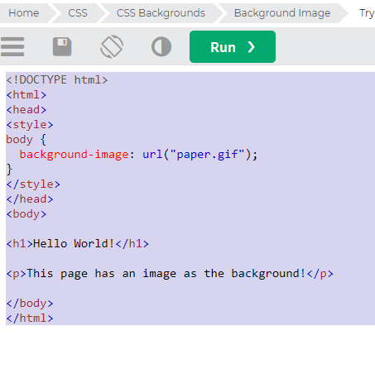
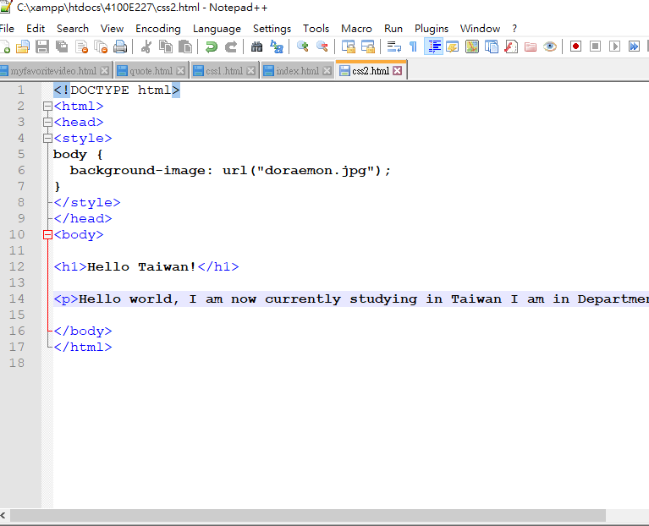

Slide 7
“Client-side Web Programming”
Client-Side Programming So far, we have talked mostly about programming on the server-side. There is no way to ignore how important the server is: it's the only thing you can rely on for security, data storage, etc. Logic can also be embedded in HTML and executed by the user's browser. The <script> tag is used to insert logic into a page. In theory, <script> can contain any language, but since you rely on browser support, it's going to be JavaScript. Like with HTML and CSS features, you are relying on the user's browser to run your code. That means… The code might not run. They might have JS turned off, Googlebot won't execute your JS, they might be using a weird browser without JS, …. The code might not work the same way it does in your browser. Different browsers implement different language features. Your have to worry about code compatibility a lot. It can be used to reference an external URL with code: <script type="text/javascript" src="codefile.js"></script> You can also embed code directly in your HTML: <script type="text/javascript"> /* code goes here */ </script> The type="text/javascript" is optional in HTML5.

Slide 8
Putting code in your HTML (instead of a separate file) is probably a bad idea. Bad style: mixing more than one language in a single file is hard to read. Hard to maintain: if some logic is broken, can be hard to find (especially since there can be multiple <script> in a page). Validation problems: if you want to make a comparison in your JavaScript: i<10 && j>0. Does that < start a tag? If embedded in HTML, that should be i&lt;10 &amp;&amp; j&gt;0. Do you want to code like that? No caching. If the user needs the same JS several times (because they return to the same page, or visit multiple pages from the same template) it must be loaded every time. In a separate file, it can be loaded once and cached. Exception: sometimes you need to call a function to get things started. That should be small, but needs to be done for the specific page. <script type="text/javascript" src="/code/main.js"></script> <script type="text/javascript"> setup_this_page(); </script>
https://www.cs.sfu.ca/~ggbaker/zju/web/js.html

Slide 9
Different browsers implement different language features. Your have to worry about code compatibility a lot. It can be used to reference an external URL with code: <script type="text/javascript" src="codefile.js"></script> You can also embed code directly in your HTML: <script type="text/javascript"> /* code goes here */ </script> The type="text/javascript" is optional in HTML5. Putting code in your HTML (instead of a separate file) is probably a bad idea. Bad style: mixing more than one language in a single file is hard to read. Hard to maintain: if some logic is broken, can be hard to find (especially since there can be multiple <script> in a page). Validation problems: if you want to make a comparison in your JavaScript: i<10 && j>0. Does that < start a tag? If embedded in HTML, that should be i&lt;10 &amp;&amp; j&gt;0. Do you want to code like that? No caching. If the user needs the same JS several times (because they return to the same page, or visit multiple pages from the same template) it must be loaded every time. In a separate file, it can be loaded once and cached. Exception: sometimes you need to call a function to get things started. That should be small, but needs to be done for the specific page. <script type="text/javascript" src="/code/main.js"></script> <script type="text/javascript"> setup_this_page(); </script>
https://www.cs.sfu.ca/~ggbaker/zju/web/js.html

Slide 10
Server Side Web Programming
Server-side website programming
The Dynamic Websites – Server-side programming topic is a series of modules that show how to create dynamic websites; websites that deliver customised information in response to HTTP requests. The modules provide a general introduction to server-side programming, along with specific beginner-level guides on how to use the Django (Python) and Express (Node.js/JavaScript) web frameworks to create basic applications.
Most major websites use some kind of server-side technology to dynamically display data as required. For example, imagine how many products are available on Amazon, and imagine how many posts have been written on Facebook. Displaying all of these using different static pages would be extremely inefficient, so instead such sites display static templates (built using HTML, CSS, and JavaScript), and then dynamically update the data displayed inside those templates when needed, such as when you want to view a different product on Amazon.
In the modern world of web development, learning about server-side development is highly recommended.

Slide 11
HTML PROGRAMMING (Hypertext Markup Language)

Slide 12
HTML PROGRAMMING
MEANING:
* HTML (Hypertext Markup Language) is the code that is used to structure a web page and its content. For example, content could be structured within a set of paragraphs, a list of bulleted points, or using images and data tables. As the title suggests, this article will give you a basic understanding of HTML and its functions.
HTML is a markup language that defines the structure of your content. HTML consists of a series of elements, which you use to enclose, or wrap, different parts of the content to make it appear a certain way, or act a certain way. The enclosing tags can make a word or image hyperlink to somewhere else, can italicize words, can make the font bigger or smaller, and so on. For example, take the following line of content: My cat is very grumpy If we wanted the line to stand by itself, we could specify that it is a paragraph by enclosing it in paragraph tags:
<p>My cat is very grumpy</p>
https://developer.mozilla.org/en
US/docs/Learn/Getting_started_with_the_web/HTML_basics

Slide 13
Anatomy of HTML elements
The main parts of our element are as follows: The opening tag: This consists of the name of the element (in this case, p), wrapped in opening and closing angle brackets. This states where the element begins or starts to take effect — in this case where the paragraph begins. The closing tag: This is the same as the opening tag, except that it includes a forward slash before the element name. This states where the element ends — in this case where the paragraph ends. Failing to add a closing tag is one of the standard beginner errors and can lead to strange results. The content: This is the content of the element, which in this case, is just text. The element: The opening tag, the closing tag, and the content together comprise the element.

Slide 14
Anatomy of HTML document
That wraps up the basics of individual HTML elements, but they aren't handy on their own. Now we'll look at how individual elements are combined to form an entire HTML page. Let's revisit the code we put into our index.html example (which we first met in the Dealing with files article):
<!DOCTYPE html>
<html> <head>
<meta charset="utf-8">
<title>My test page</title>
</head> <body> <img src="images/firefox-icon.png" alt="My test image">
</body>
</html>

Slide 15
Here, we have the following: <!DOCTYPE html> — doctype. It is a required preamble. In the mists of time, when HTML was young (around 1991/92), doctypes were meant to act as links to a set of rules that the HTML page had to follow to be considered good HTML, which could mean automatic error checking and other useful things. However these days, they don't do much and are basically just needed to make sure your document behaves correctly. That's all you need to know for now. <html></html> — the <html> element. This element wraps all the content on the entire page and is sometimes known as the root element. <head></head> — the <head> element. This element acts as a container for all the stuff you want to include on the HTML page that isn't the content you are showing to your page's viewers. This includes things like keywords and a page description that you want to appear in search results, CSS to style our content, character set declarations, and more. <meta charset="utf-8"> — This element sets the character set your document should use to UTF-8 which includes most characters from the vast majority of written languages. Essentially, it can now handle any textual content you might put on it. There is no reason not to set this and it can help avoid some problems later on. <title></title> — the <title> element. This sets the title of your page, which is the title that appears in the browser tab the page is loaded in. It is also used to describe the page when you bookmark/favorite it. <body></body> — the <body> element. This contains all the content that you want to show to web users when they visit your page, whether that's text, images, videos, games, playable audio tracks, or whatever else.

Slide 16
“IMAGE”
IMAGE Let's turn our attention to the <img> element again: <img src="images/firefox-icon.png" alt="My test image"> Copy to Clipboard As we said before, it embeds an image into our page in the position it appears. It does this via the src (source) attribute, which contains the path to our image file.

Slide 17
“MARKING UP TEXT”
This section will cover some of the essential HTML elements you'll use for marking up the text. Headings Heading elements allow you to specify that certain parts of your content are headings — or subheadings. In the same way that a book has the main title, chapter titles, and subtitles, an HTML document can too. HTML contains 6 heading levels, <h1>–<h6>, although you'll commonly only use 3 to 4 at most:
<!-- 4 heading levels: -->
<h1>My main title</h1>
<h2>My top level heading</h2>
<h3>My subheading</h3>
<h4>My sub-subheading</h4>

Slide 18
“PARAGRAPHS”
As explained above, <p> elements are for containing paragraphs of text; you'll use these frequently when marking up regular text content: <p>This is a single paragraph</p> Copy to Clipboard Add your sample text (you should have it from What will your website look like?) into one or a few paragraphs, placed directly below your <img> element.
<p>This is a single paragraph</p> Copy to Clipboard Add your sample text (you should have it from What will your website look like?) into one or a few paragraphs, placed directly below your <img> element.

Slide 19
“LIST”
A lot of the web's content is lists and HTML has special elements for these. Marking up lists always consists of at least 2 elements. The most common list types are ordered and unordered lists:
Unordered lists are for lists where the order of the items doesn't matter, such as a shopping list. These are wrapped in a <ul> element. Ordered lists are for lists where the order of the items does matter, such as a recipe. These are wrapped in an <ol> element. Each item inside the lists is put inside an <li> (list item) element.

Slide 20
For example, if we wanted to turn the part of the following paragraph fragment into a list <p>At Mozilla, we’re a global community of technologists, thinkers, and builders working together ... </p>
Copy to Clipboard
We could modify the markup to this:
<p>At Mozilla, we’re a global community of</p> <ul>
<li>technologists</li>
<li>thinkers</li>
<li>builders</li>
</ul> <p>working together ... </p>

Slide 21
“LINKS”
Links are very important — they are what makes the web a web! To add a link, we need to use a simple element — <a> — "a" being the short form for "anchor". To make text within your paragraph into a link, follow these steps:
Choose some text. We chose the text "Mozilla Manifesto". Wrap the text in an <a> element, as shown below: <a>Mozilla Manifesto</a> Copy to Clipboard Give the <a> element an href attribute, as shown below:
<a href="">Mozilla Manifesto</a> Copy to Clipboard Fill in the value of this attribute with the web address that you want the link to link to:
<a href="https://www.mozilla.org/en-US/about/manifesto/">Mozilla Manifesto</a>
Copy to Clipboard You might get unexpected results if you omit the https:// or http:// part, called the protocol, at the beginning of the web address. After making a link, click it to make sure it is sending you where you wanted it to.
Ref: https://developer.mozilla.org/en
US/docs/Learn/Getting_started_with_the_web/HTML_basics

Slide 22
CSS (Cascading Style Sheets)

Slide 23
CSS (Cascading Style Sheets)
is the code that styles web content. CSS basics walks through what you need to get started. We'll answer questions like: How do I make text red? How do I make content display at a certain location in the (webpage) layout? How do I decorate my webpage with background images and colors?
Like HTML, CSS is not a programming language. It's not a markup language either. CSS is a style sheet language. CSS is what you use to selectively style HTML elements. For example, this CSS selects paragraph text, setting the color to red:
p { color: red;
}
Copy to Clipboard Let's try it out! Using a text editor, paste the three lines of CSS (above) into a new file. Save the file as style.css in a directory named styles.

Slide 24
JAVASCRIPT

Slide 25
“JAVASCRIPT”
JavaScript is a programming language that adds interactivity to your website. This happens in games, in the behavior of responses when buttons are pressed or with data entry on forms; with dynamic styling; with animation, etc. This article helps you get started with JavaScript and furthers your understanding of what is possible.
JavaScript is versatile and beginner-friendly. With more experience, you'll be able to create games, animated 2D and 3D graphics, comprehensive database-driven apps, and much more!

Slide 26
XAMPP (cross-platform, Apache, MySQL, PHP and Perl)

Slide 27
“XAMPP”
is a software distribution which provides the Apache web server, MySQL database (actually MariaDB), Php and Perl (as command-line executables and Apache modules) all in one package. It is available for Windows, MAC and Linux systems. No configuration is necessary to integrate Php with MySQL.
It is a great fit for this course and provides a relatively painless installation and way to manage the configuration changes. Also provided is PhpMyadmin which gives a GUI tool for managing your MySQL databases. I would highly recommend installing this for Windows. It doesn't exclude you from other competing software installations, it just gives an easy way to get going. For Ubuntu Linux systems, I still would recommend installing Apache/MySQL/Php/PhpMyadmin through Ubuntu packages. The XAMPP download site which I use is:
https://www.apachefriends.org/ The installation I'm describing uses Php 7.3.

Slide 28
The MySQL clients The MySQL Client executables are located in the directory C:\xampp\mysql\bin The most important one is the client program mysql.exe.
Ref: https://www.cs.wcupa.edu/rkline/index/xampp.html

Slide 29
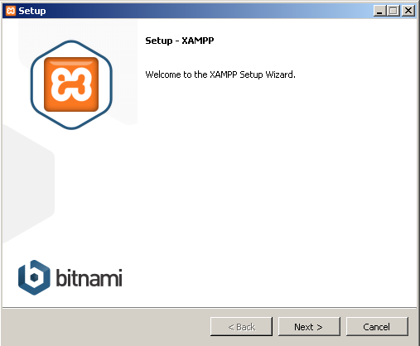

Slide 30
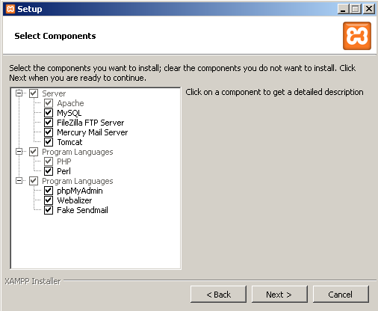

Slide 31
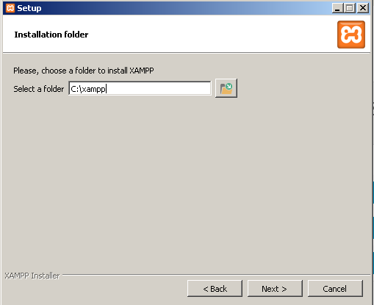

Slide 34
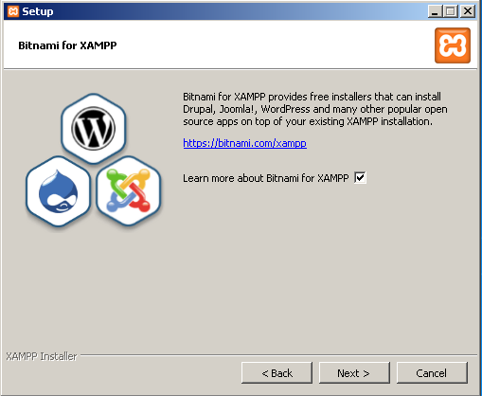

Slide 35
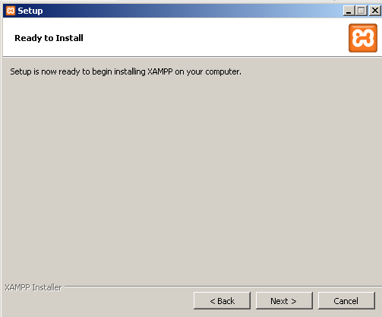

Slide 36
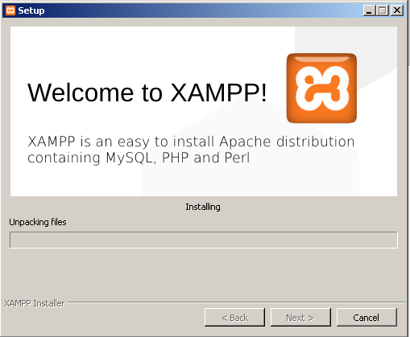

Slide 37
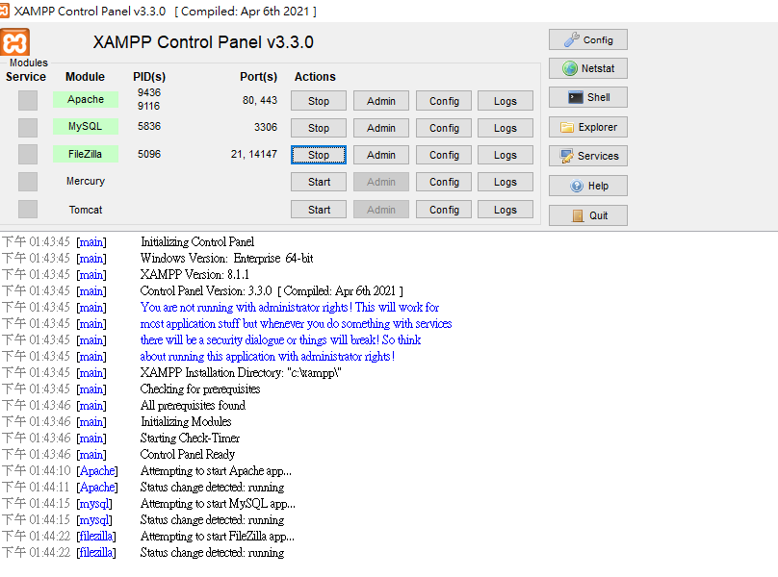
Run XAMPP Control Panel as administrator What you want to run is the XAMPP Control Panel found under XAMPP in the Start menu. Right-click and run this as administrator. Start both MySQL and Apache (unless you have an alternative Apache installation). I do not recommend messing with the Modules service column. When you start MySQL, you should see it running on port 3306. The Apache service gives you access to the Admin buttons next to the services. For Apache Admin, you get: http://localhost/dashboard For MySQL Admin you get PhpMyadmin: http://localhost/phpmyadmin

Slide 38
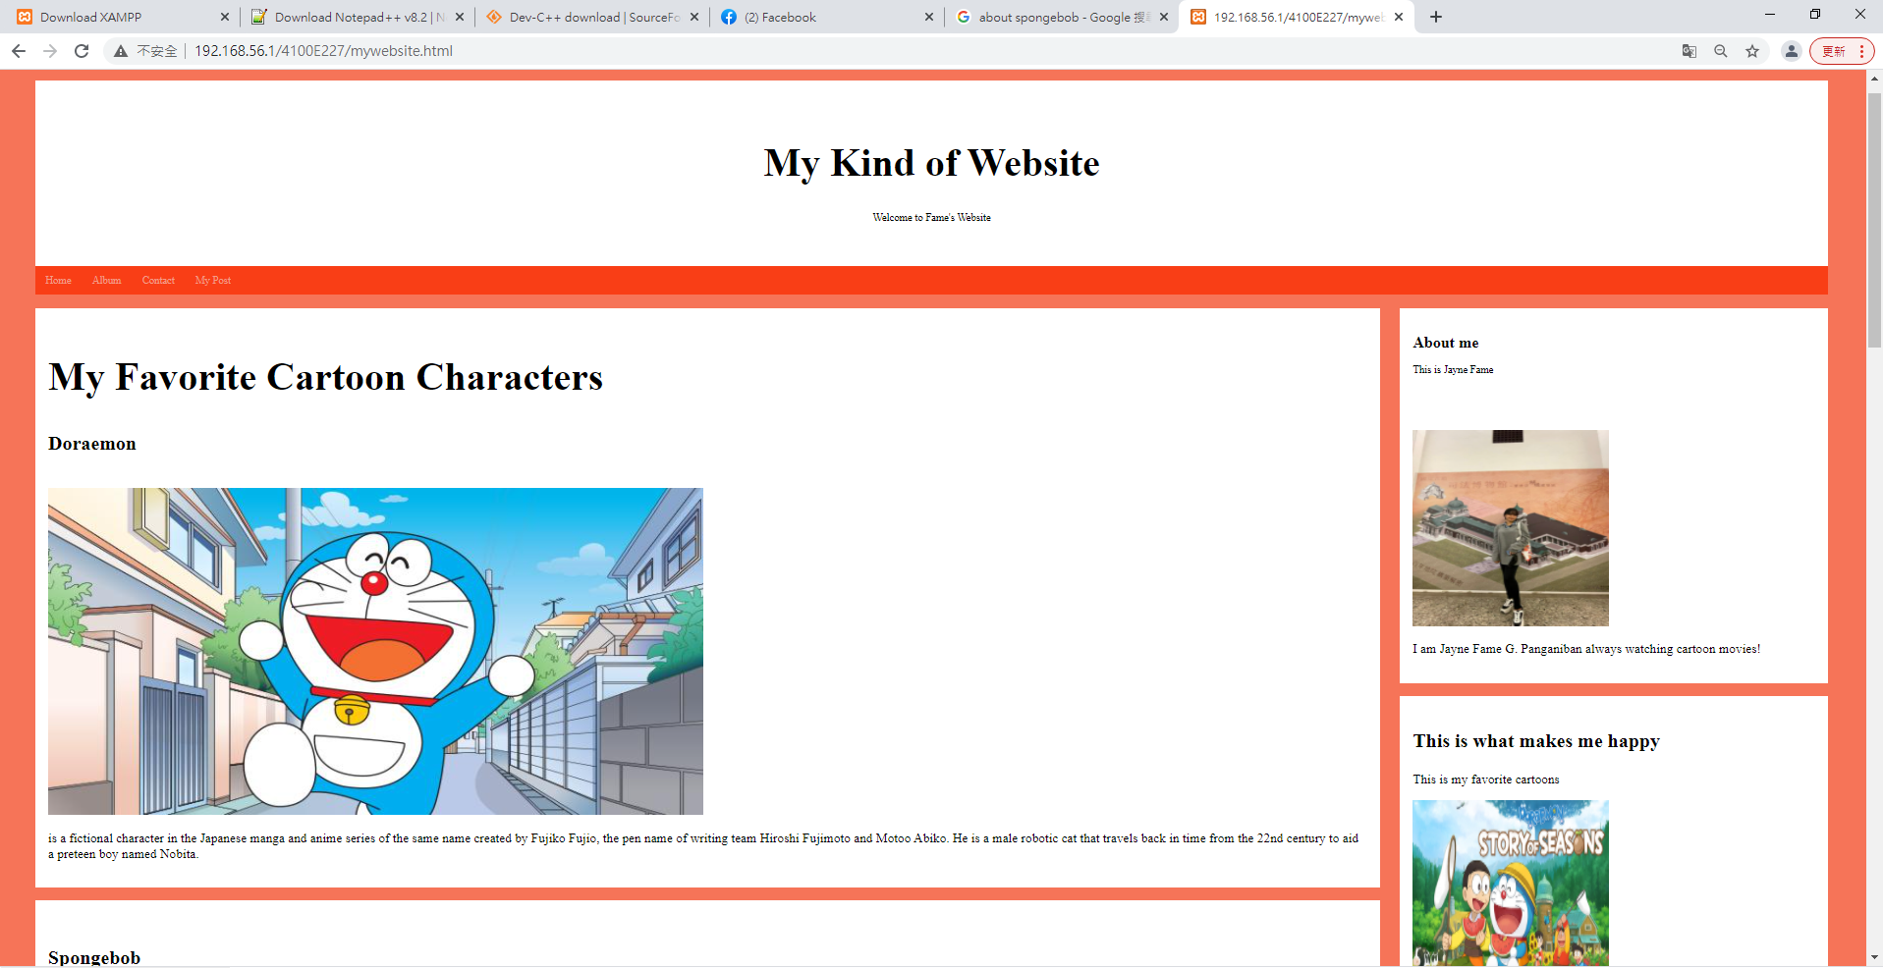
mywebsite

Slide 39

Myfavoritevideo.html

Slide 40
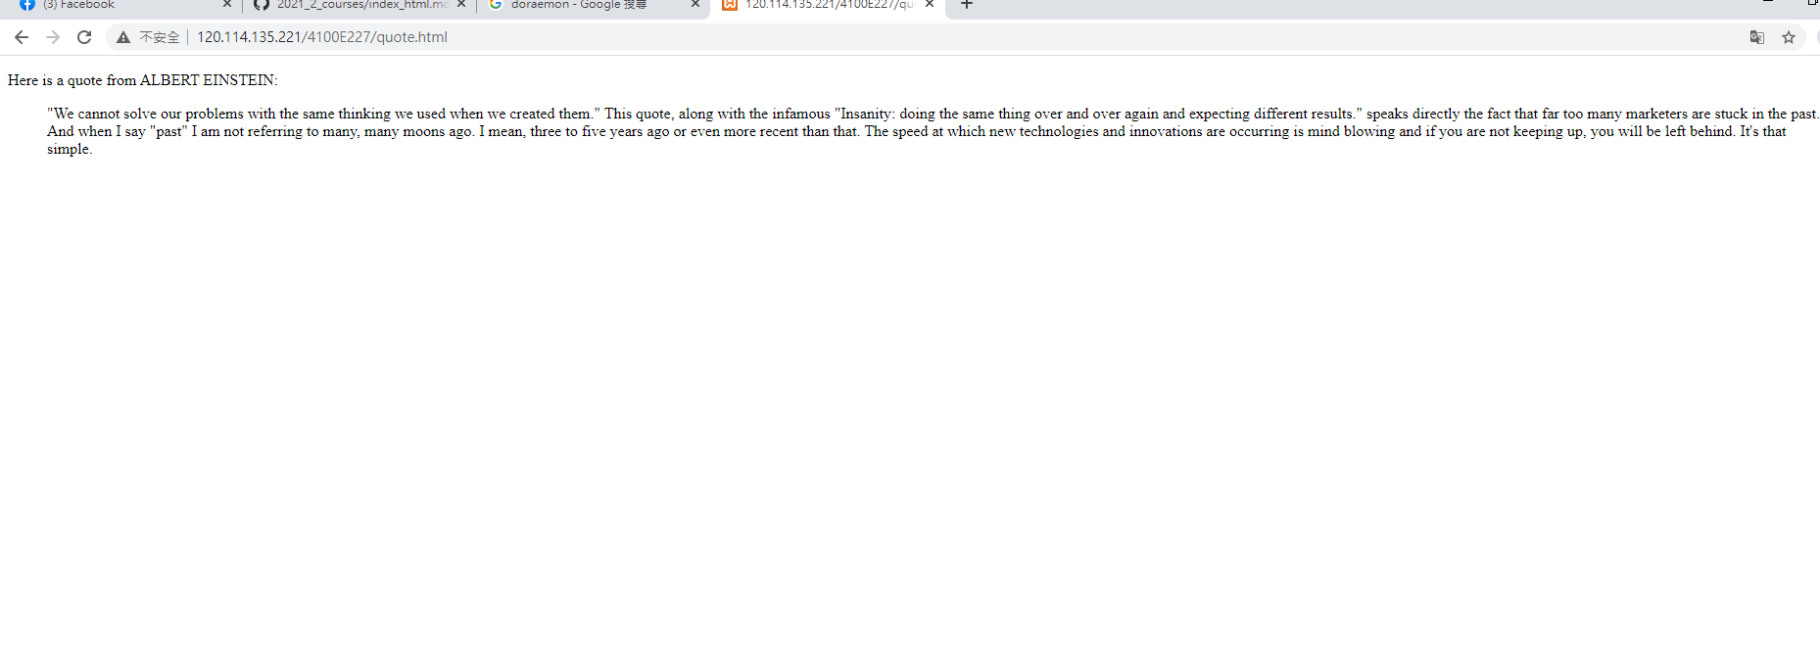
Quote.html

Slide 41
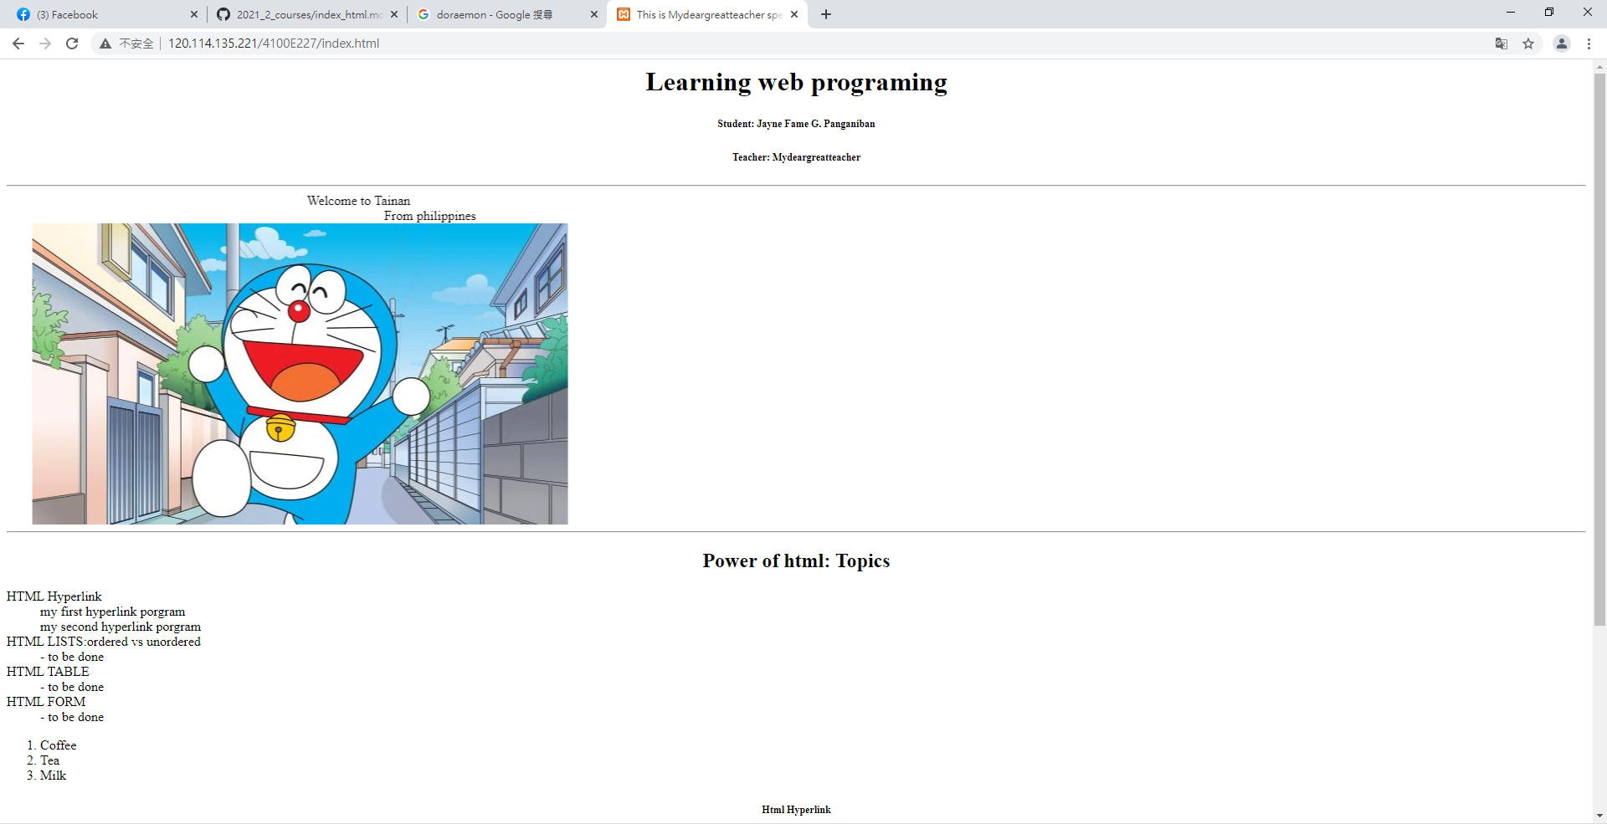
Index.html

Slide 42
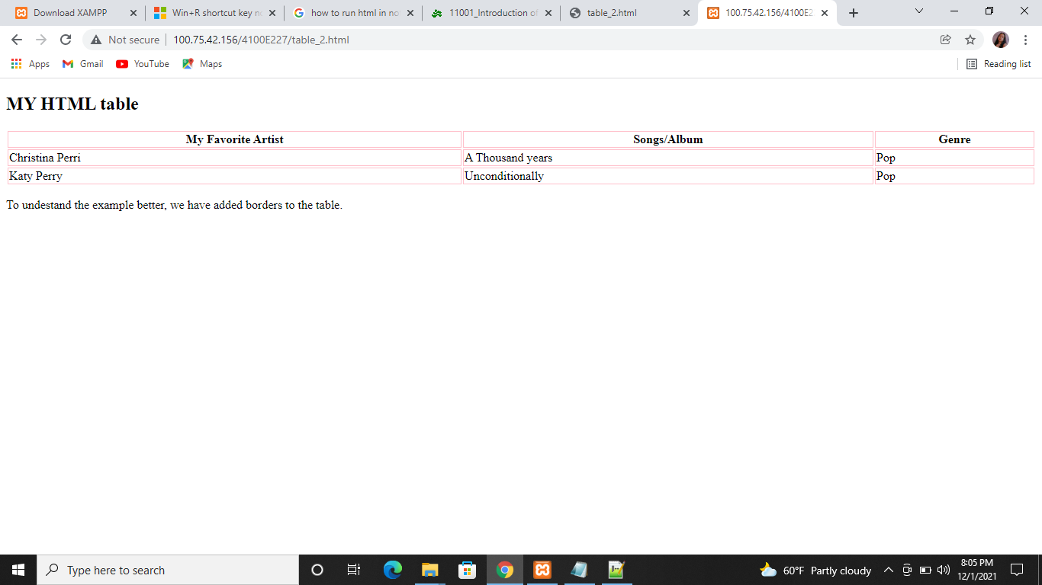
table1.html

Slide 43
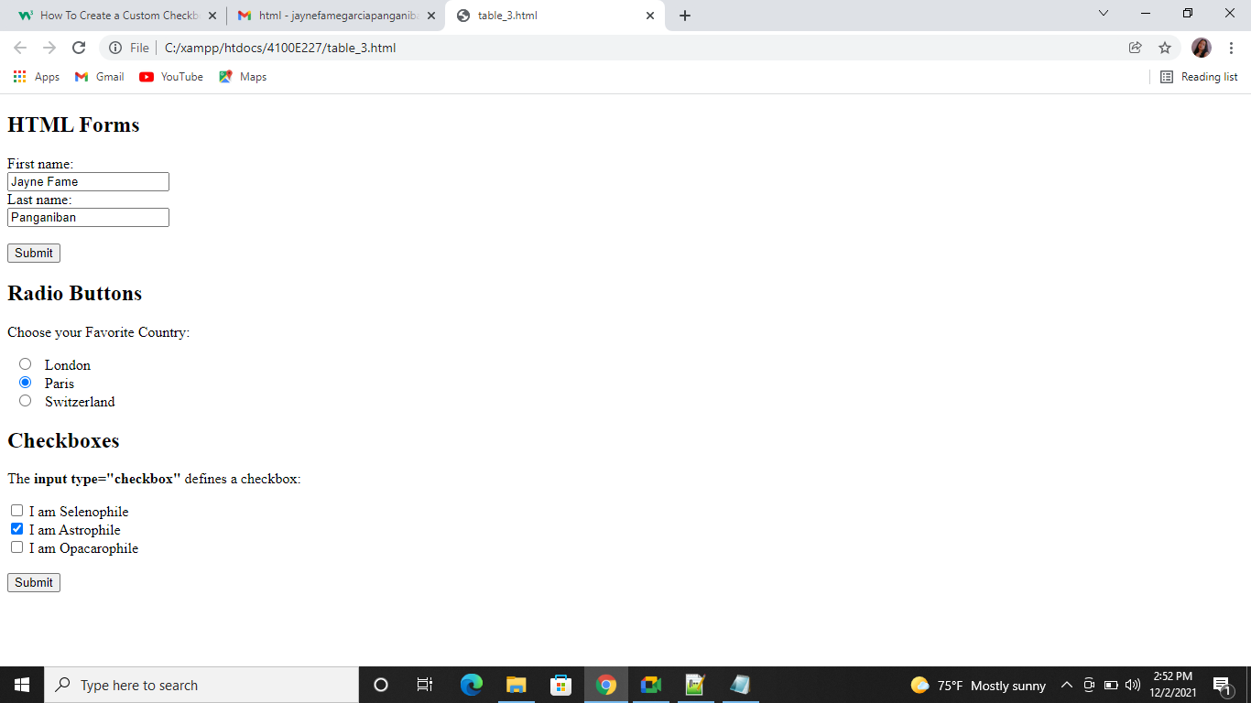
table2.html

Slide 44
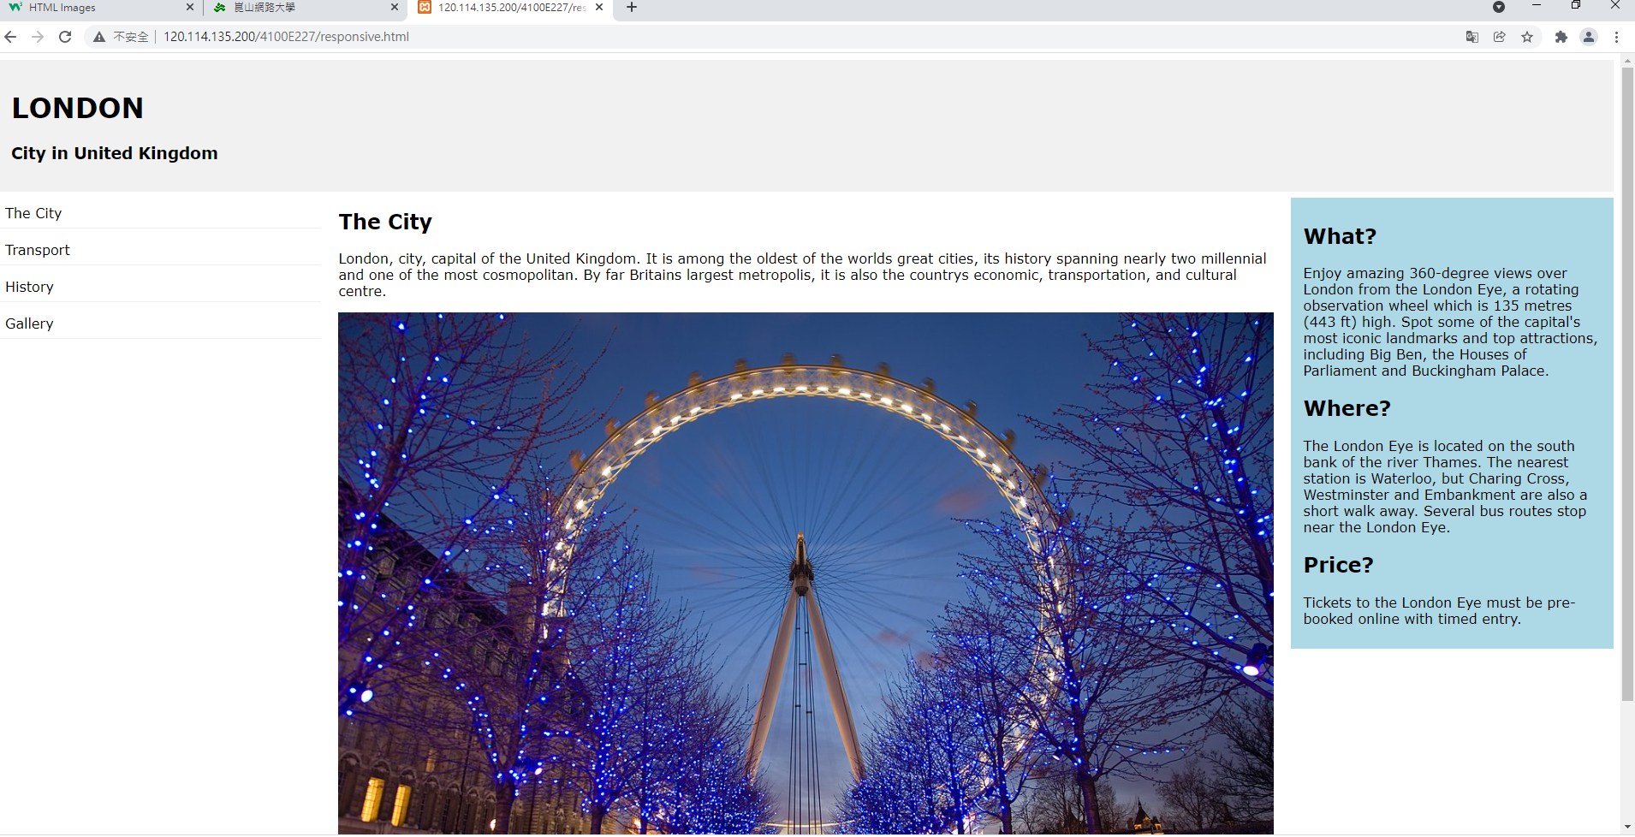
Responsive.html

Slide 45

Image.html

Slide 46
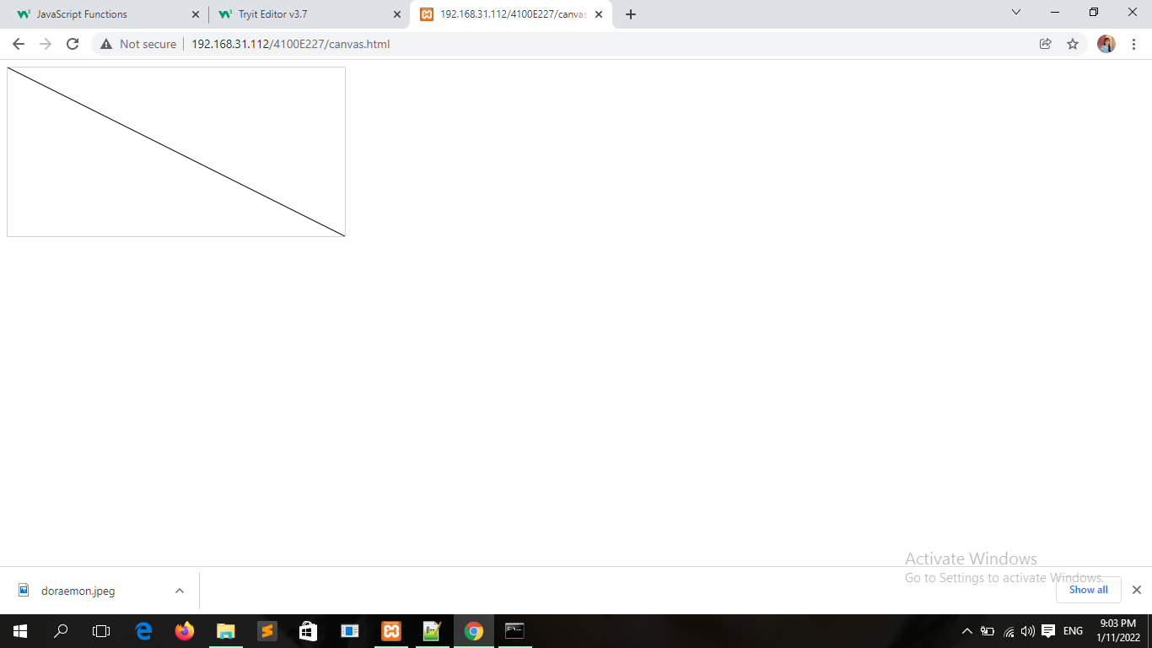
Canvas.html

Slide 47
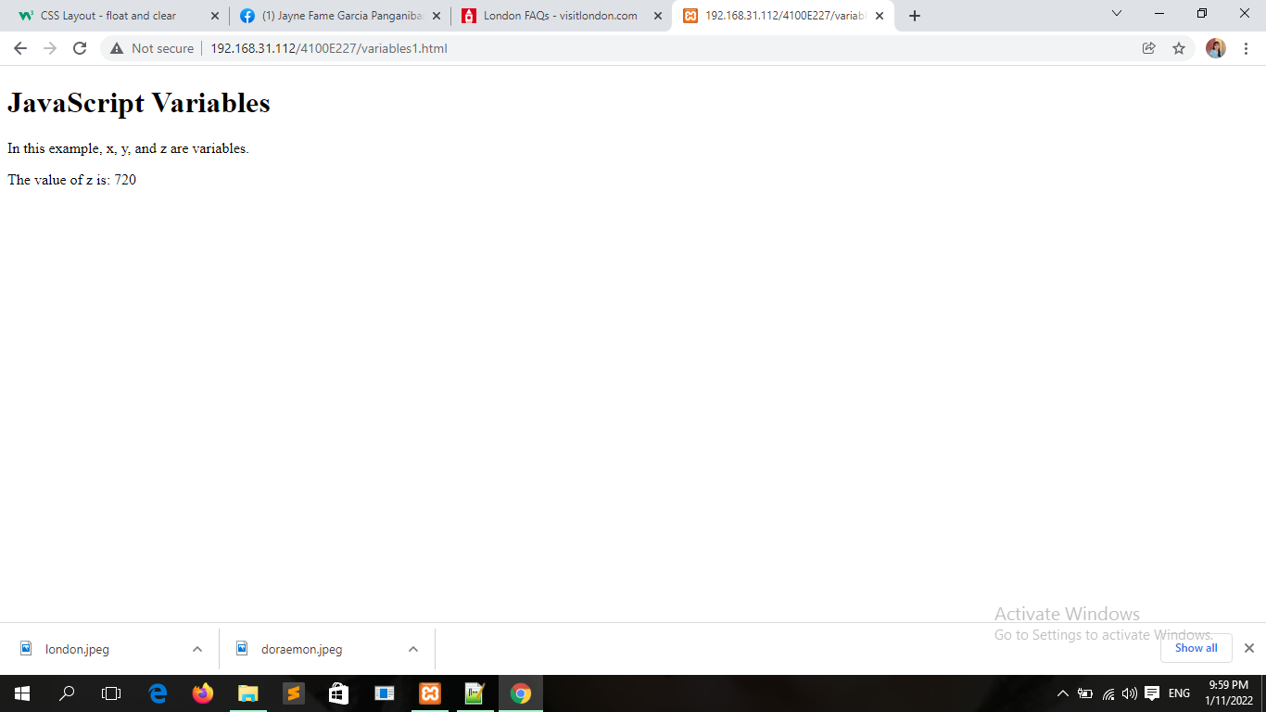
Javascript variables

Slide 48
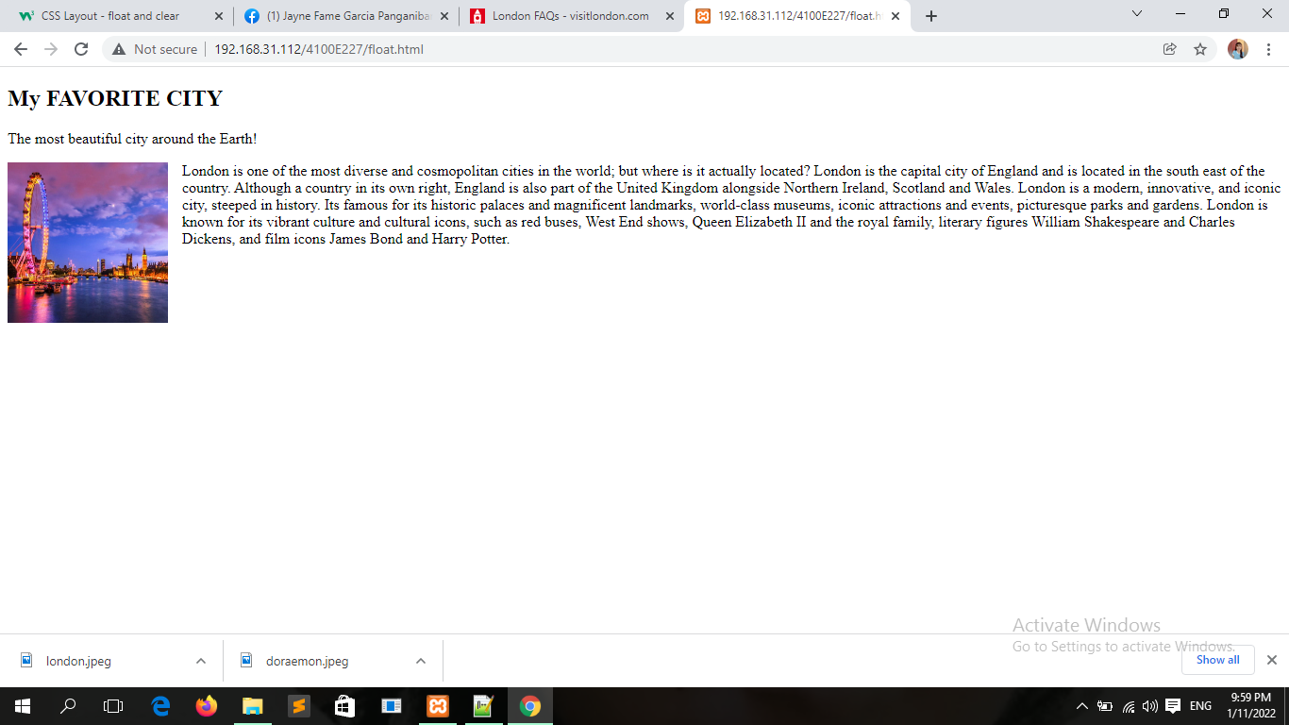
Float.html

Slide 49
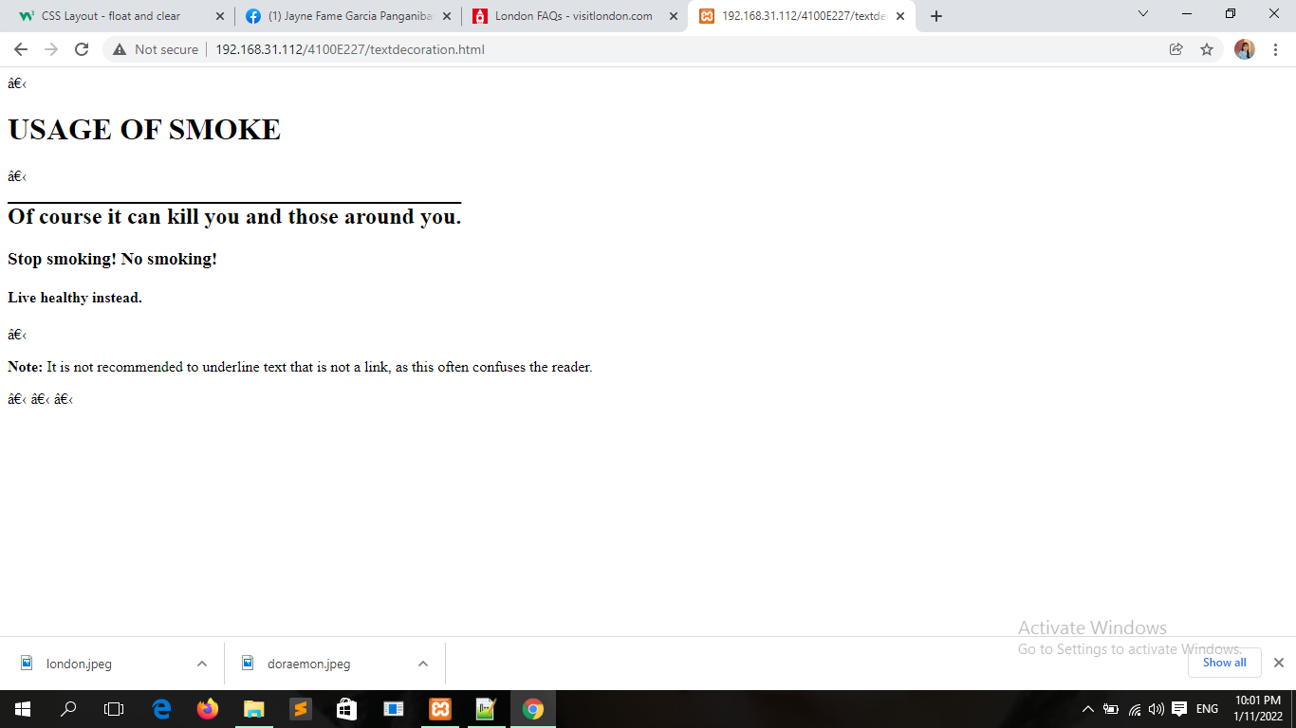
Textdecoration.html

Slide 50
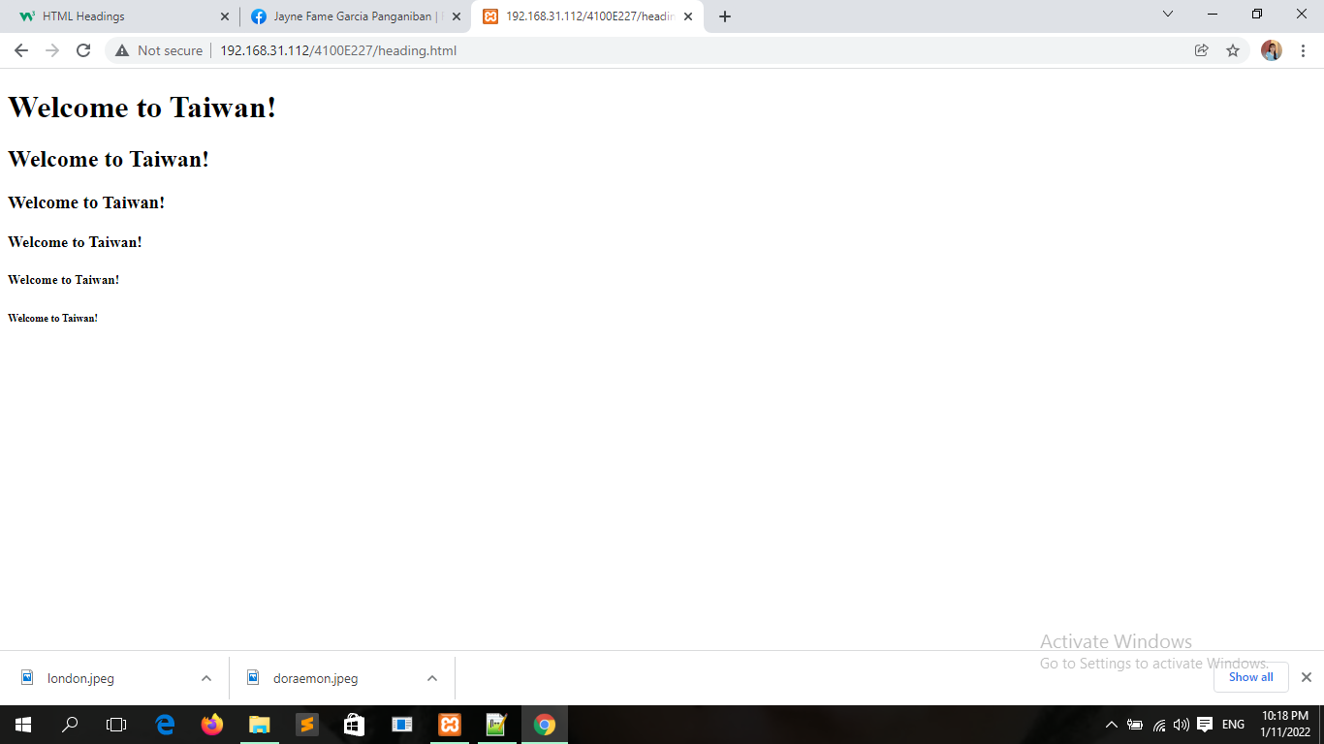
Heading.html

Slide 51
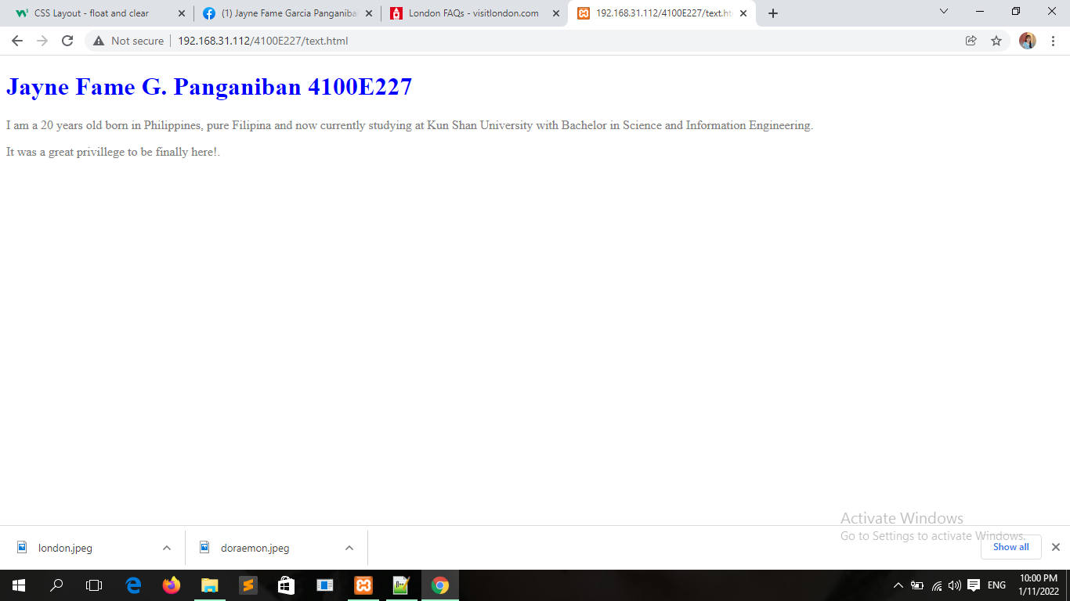
Text.html

Slide 52
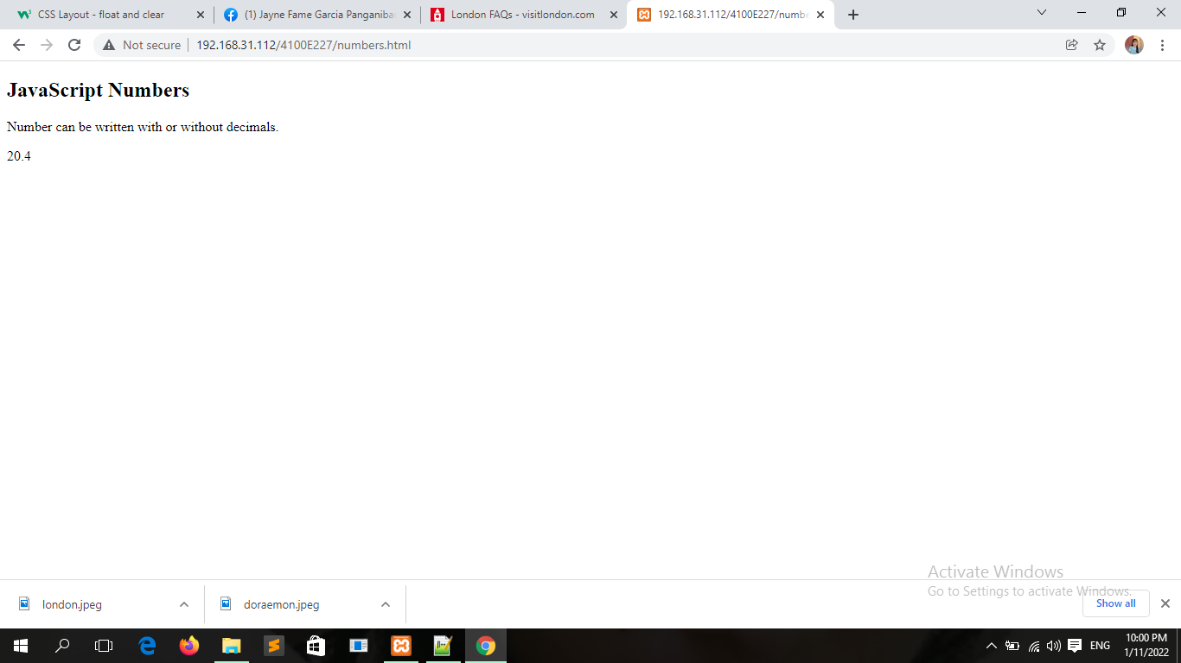
Javascript numbers

Slide 53
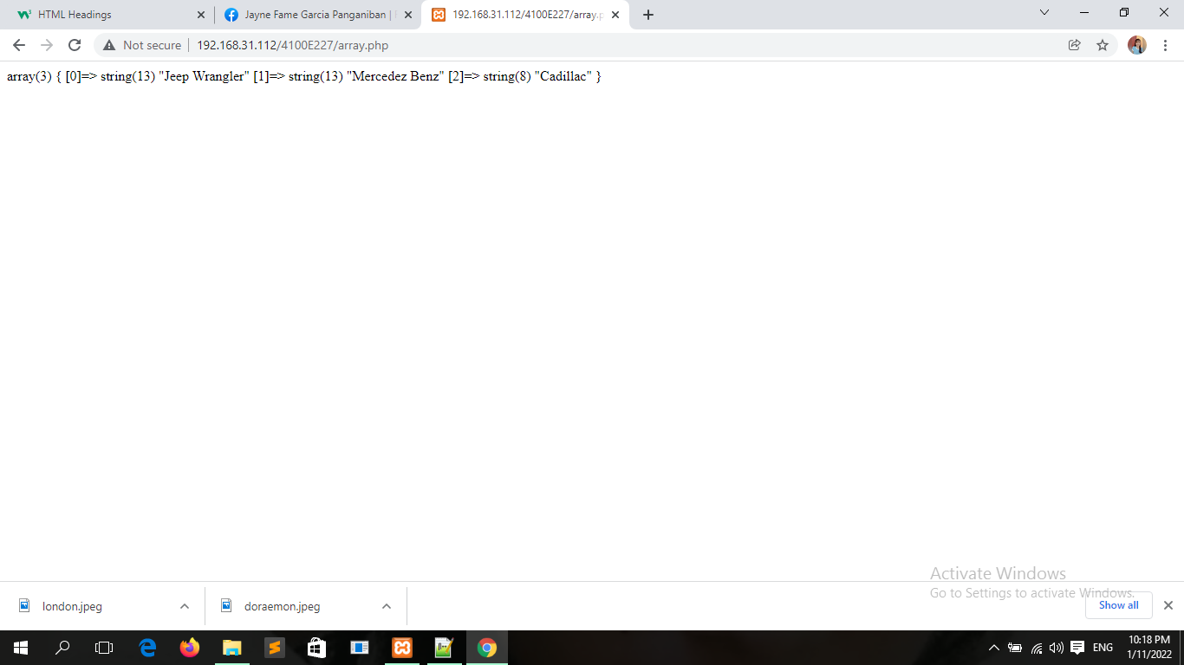
Array.php

Slide 54
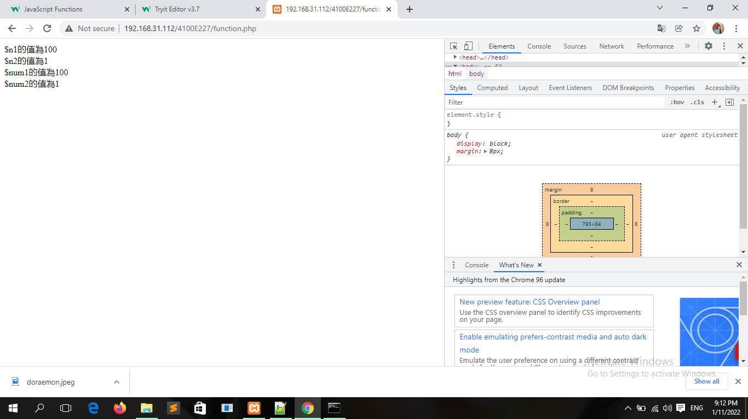
Function.php

Slide 55
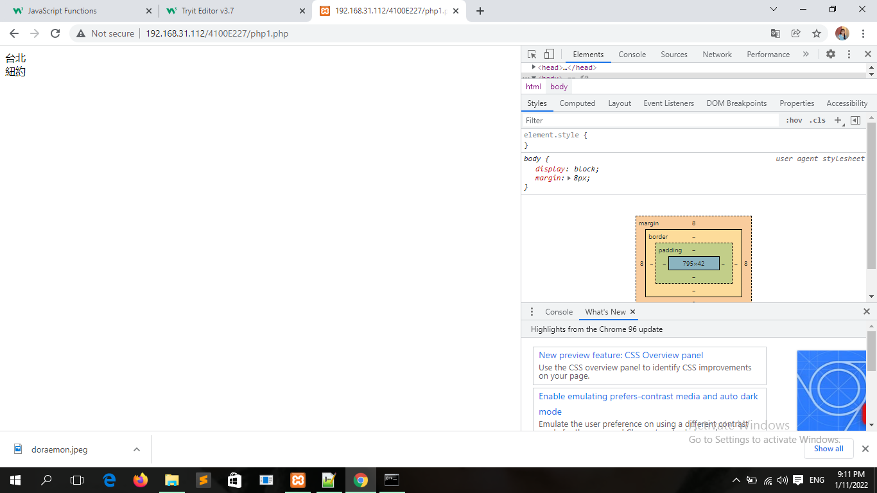
Php1.php

Slide 56

Php2.php

Slide 57
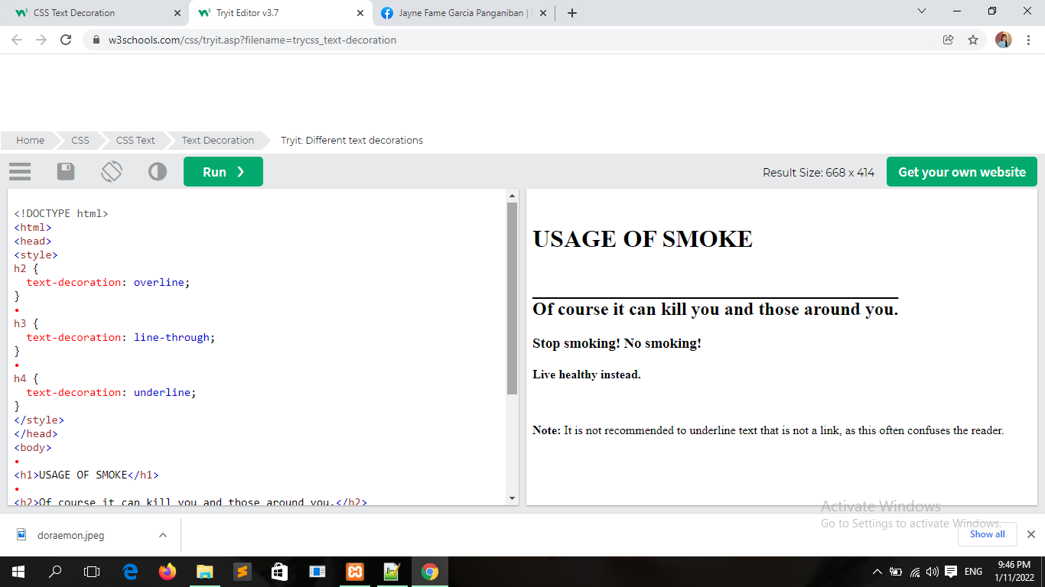

Slide 58
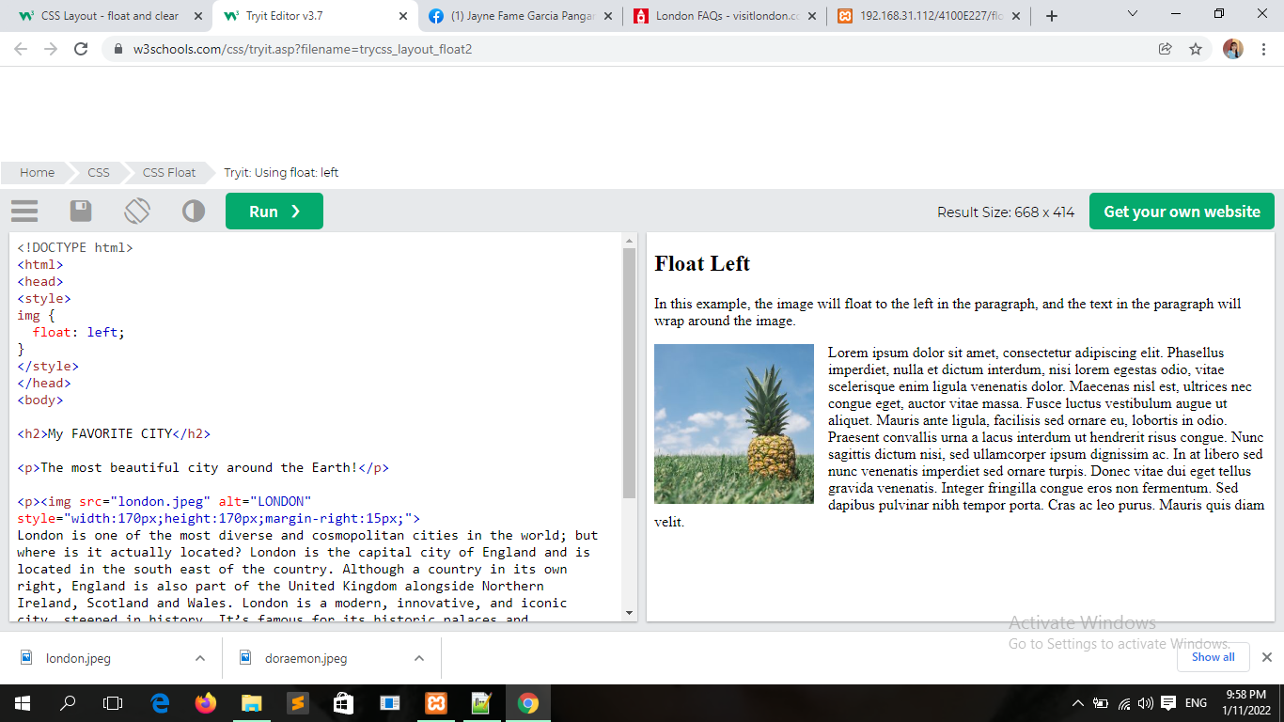

Slide 59
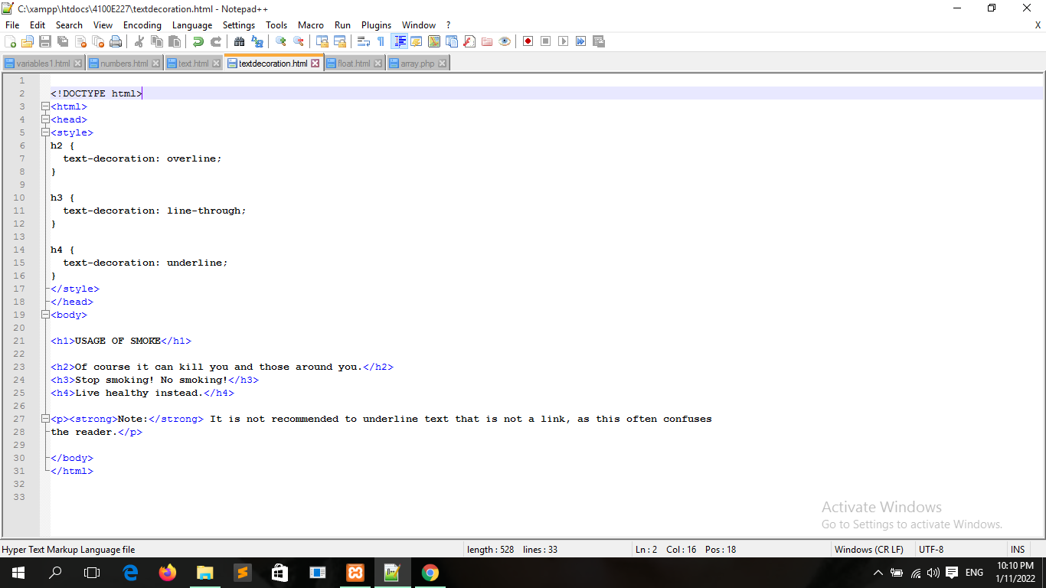

Slide 60
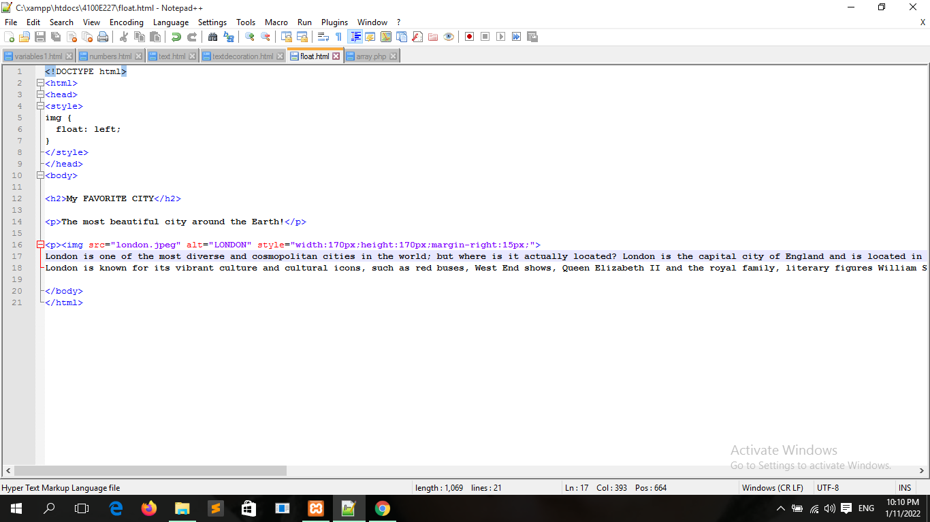

Slide 61
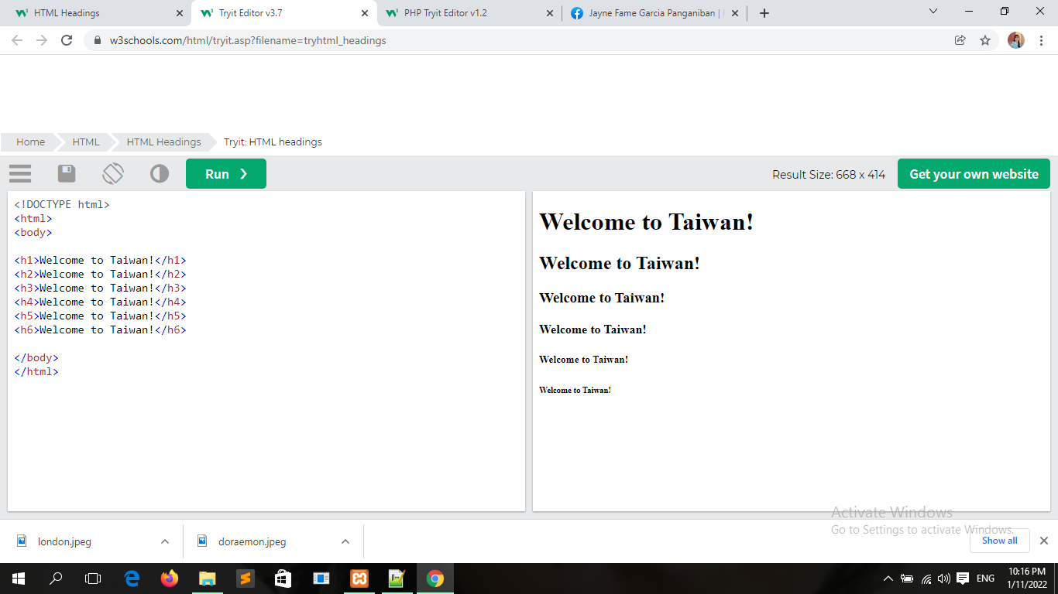

Slide 62
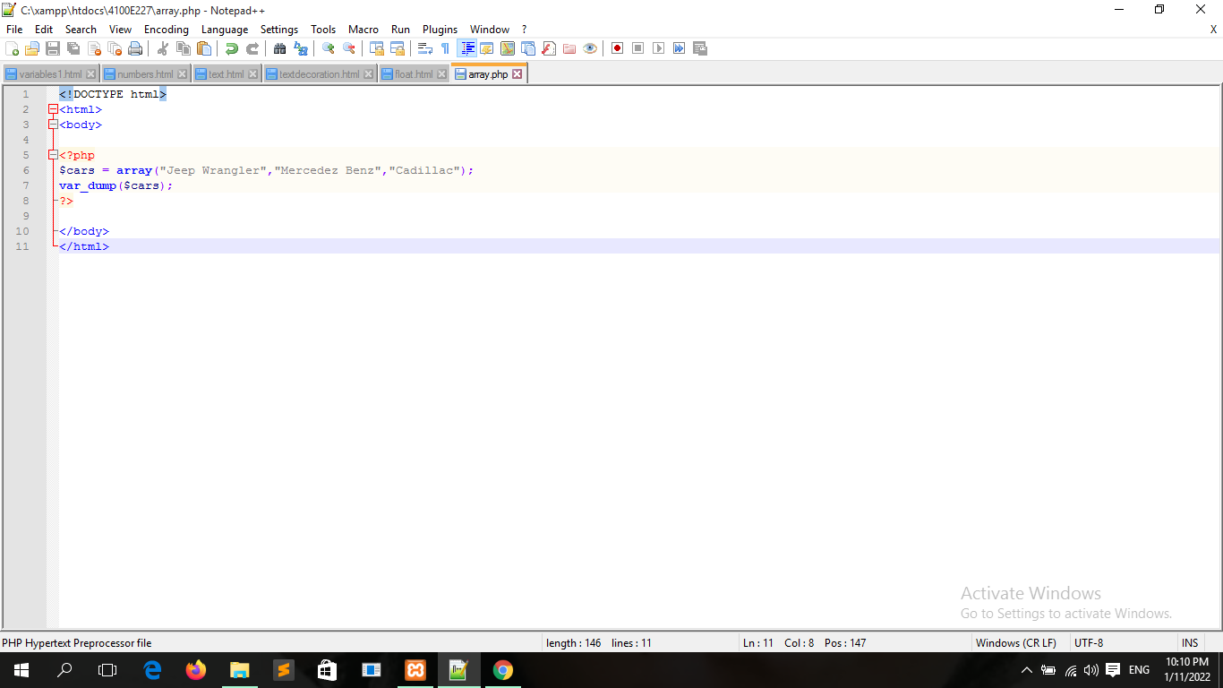

Slide 63
